Slide 1



Area defense system

Slide 2
GROUP NAME : ND
GROUP MEMBER:
1. Rokibul Hasan
2. Md. Abdud Diyan

Slide 3

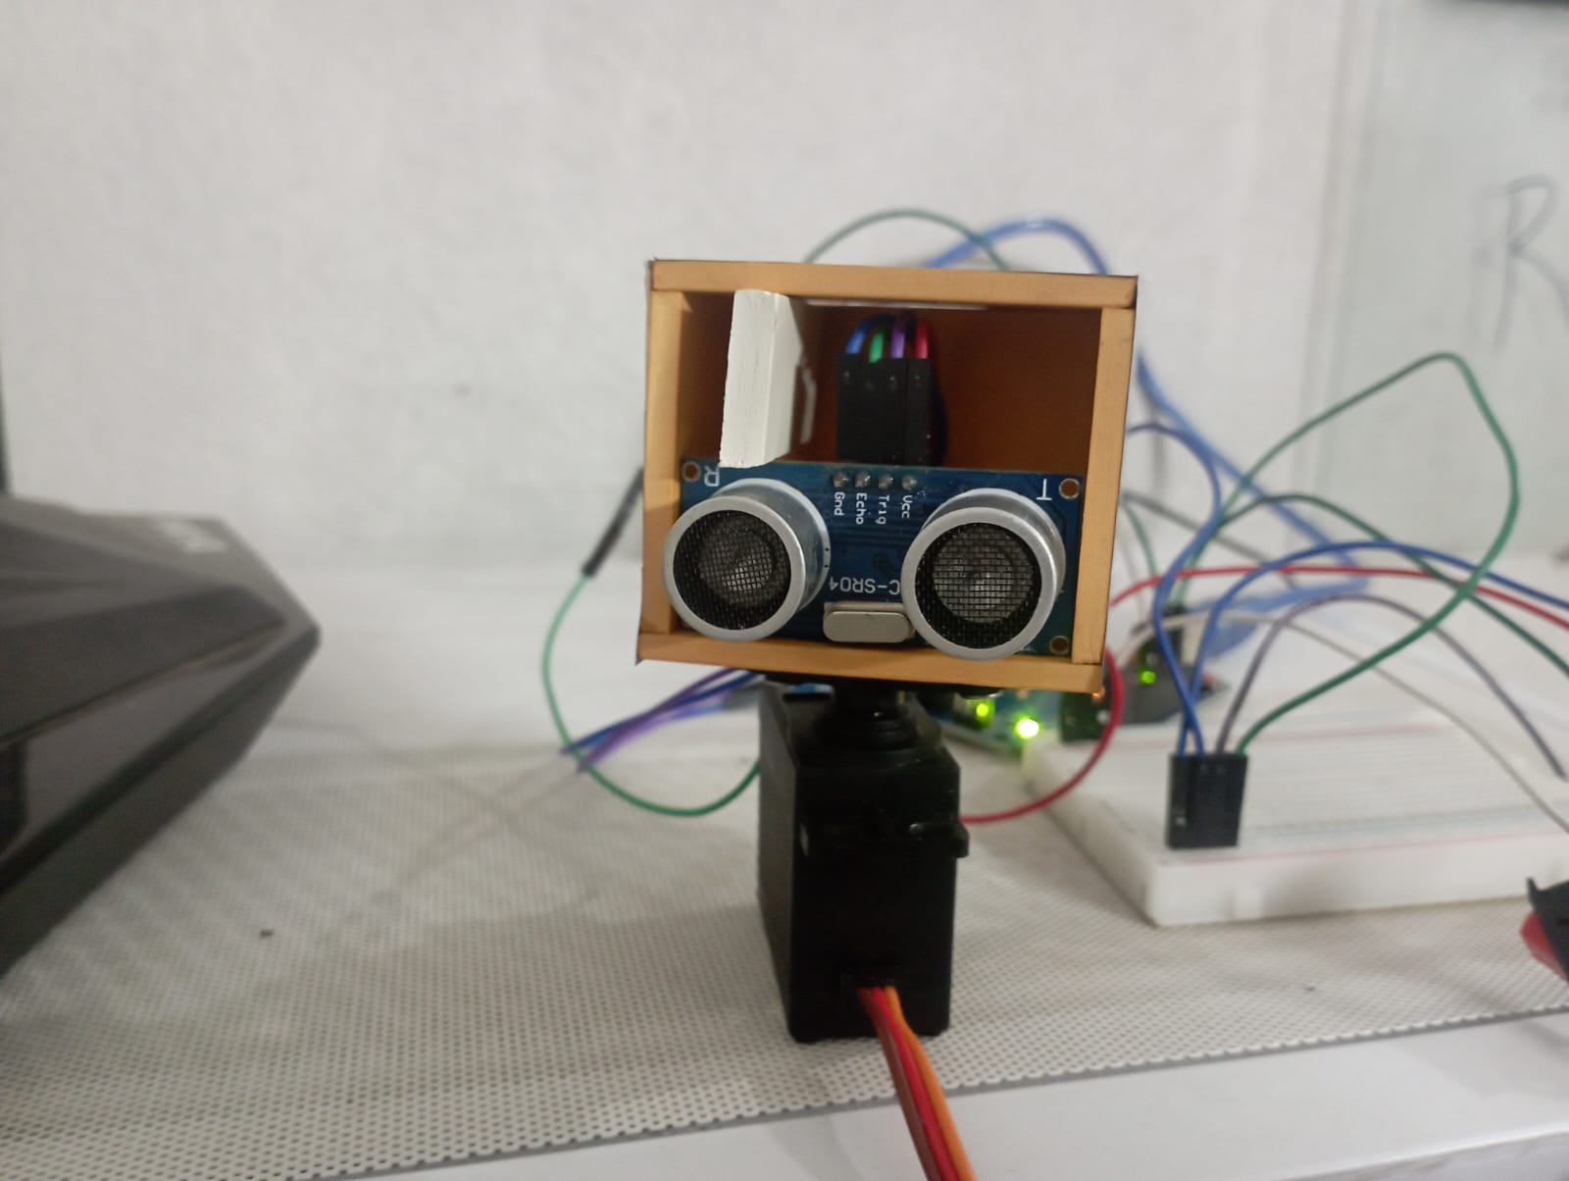
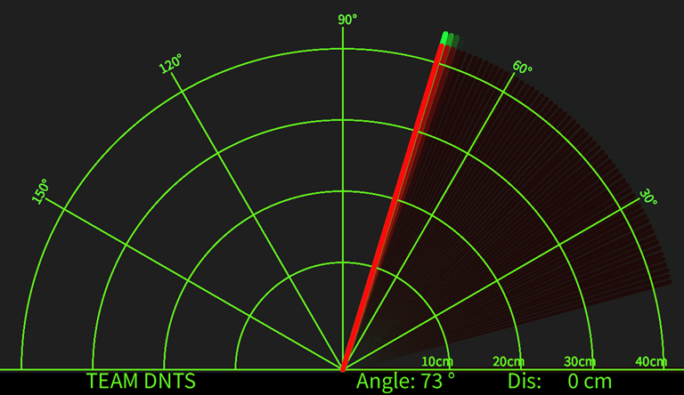
RADAR SYSTEM
Introduction :
Radar , an electromagnetic sensor used for detecting, locating, tracking, and recognizing objects of various kinds at considerable distances. It operates by transmitting electromagnetic energy toward objects and observing the echoes returned from them.

Slide 4

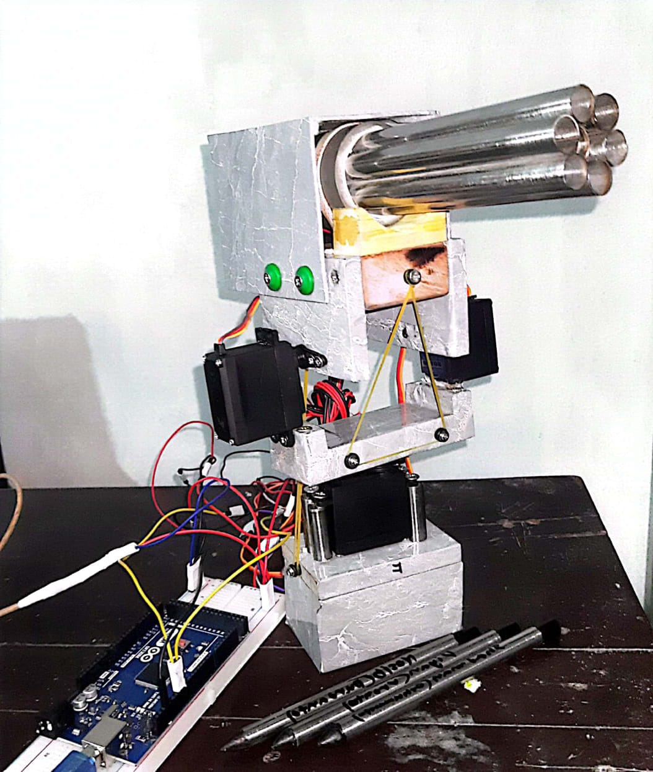
Introduction :
Automated Missile Launcher serves to protect a pre-determined zone from encroaching air threats. The launch vehicle provides firing, survey control, ground navigation and automated launching pod laying on the target.
AUTOMATED MISSILE LAUNCHER

Slide 5
Introduction :
The laser based security system is designed to provide maximum security to a given restricted area where the presence of any person or object is not desired. If someone tries to pass over the boundary line defined by laser lights , an alarm will be triggered and a large amount of sound will be sent to the authority,
LASER SECURITY SYSTEM

